Slide 1

Artificial Intelligence
Lecture 7: Reinforcement Learning

Slide 2
Overview
Review: Markov Decision Process (MDPs)
Reinforcement Learning (RL)
Model-Based Learning
Model-Free Learning
Passive RL
Active RL

Slide 3

Review: Markov Decision Process (MDPs)
in
(2/3): $4
stay
in,stay
quit
(1/3): $4
in,quit
1: $10
end
Definition: Markov Decision Process
States: the set of states
s_{start} ∈ States: starting state
Actions(s): possible actions from state s
T (s, a, s’): probability of s’ if take action a in state s
Reward (s, a, s’): reward for the transition (s, a, s’)
IsEnd(s): whether at end of game
0 ≤ γ ≤ 1: discount factor (default: 1)

Slide 4
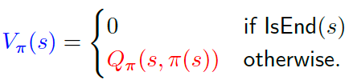
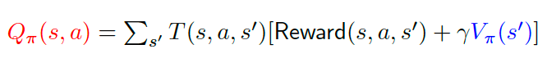
Review: Markov Decision Process (MDPs)
Following a policy π produces a path (episode)
s₀; a₁, r₁, s₁; a₂, r₂, s₂; a₃, r₃, s₃; . . . ; a_{n}, r_{n}, s_{n}
Value function V_{π} (s): expected utility if follow π from state s
Q-value function Q_{π} (s, a): expected utility if first take action a from state s and then follow π

Slide 5
Unknown transitions and rewards
Definition: Markov Decision Process
States: the set of states
s_{start} ∈ States: starting state
Actions(s): possible actions from state s
IsEnd(s): whether at end of game
0 ≤ γ ≤ 1: discount factor (default: 1)

Slide 6

Learn to make good sequences of decisions

Slide 7
What is Reinforcement Learning
Fundamental challenge in artificial intelligence and machine learning is learning to make good decisions under uncertainty
People and animals learn by interacting with our environment
This differs from certain other types of learning
It is active rather than passive
Interactions are often sequential — future interactions can depend on earlier ones
We are goal-directed
We can learn without examples of optimal behaviour
Instead, we optimise some reward signal
Reinforcement learning is based on the reward hypothesis:
Any goal can be formalized as the outcome of maximizing a cumulative reward

Slide 8


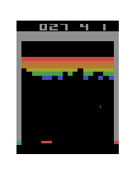
2010s: New Era of RL. Atari
Before any training
In early stages of training
In later stages of training
https://www.youtube.com/watch?v=V1eYniJ0Rnk
DeepMind Nature, 2015

Slide 9
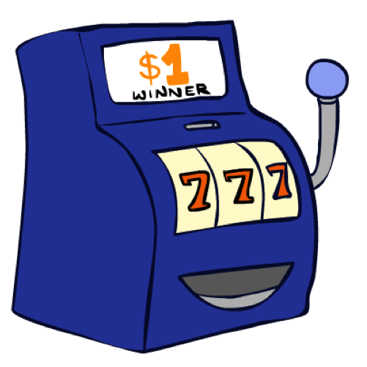
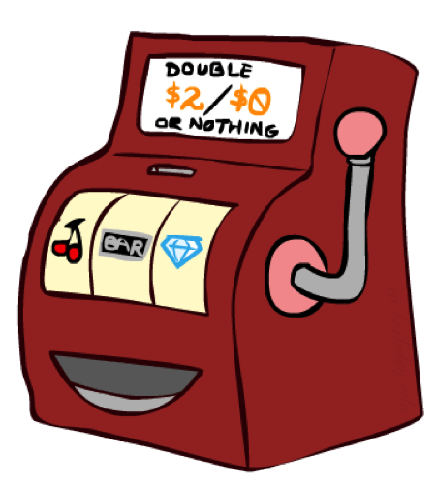

Double Bandits
0.25 $0
0.75
$2
W
0.25
$0
Actions: Blue, Red
States: Win, Lose
L
$1
1.0
$1
1.0
0.75 $2

Slide 10
Offline Planning
0.25 $0
No discount
100 time steps
Both states have the same value
0.75
$2
W
0.25
$0
L
$1
1.0
$1
1.0
0.75 $2
Value
Play Red
150
What is the right thing or optimal policy here?
Play Blue
100
Solving MDPs is offline planning
You determine all quantities through computation
You need to know the details of the MDP
You do not actually play the game!
7

Slide 11
Let’s Play!
$2
$2
$0
$2
$2
$2
$2
$0
$0
$0

Slide 12
Online Planning
Rules changed! Red’s win chance is different.
?? $0
??
$2
W
L
??
$0
$1
1.0
$1
1.0
?? $2

Slide 13
Let’s Play!
$0
$0
$0
$2
$0
$2
$0
$0
$0
$0

Slide 14
What Just Happened?
That wasn’t planning, it was learning!
Specifically, reinforcement learning
There was an MDP, but you couldn’t solve it with just computation
You needed to actually act to figure it out
Important ideas in reinforcement learning that came up
Exploration: you have to try unknown actions to get information
Exploitation: eventually, you have to use what you know
Regret: even if you learn intelligently, you make mistakes
Sampling: because of chance, you have to try things repeatedly
Difficulty: learning can be much harder than solving a known MDP

Slide 15

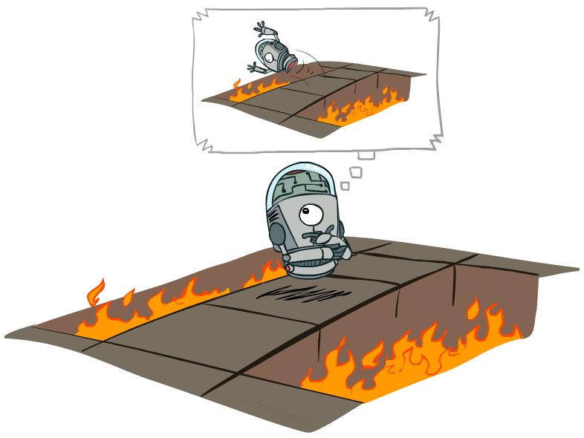
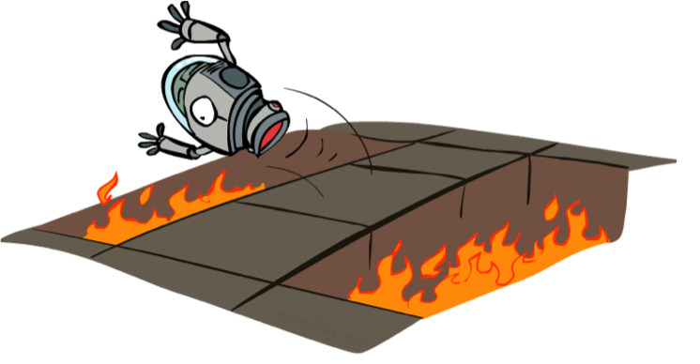

From MDPs to reinforcement learning
Markov decision process (offline)
Have mental model of how the world works.
Find policy to collect maximum rewards.
Reinforcement learning (online)
Don’t know how the world works.
Perform actions in the world to find out and collect rewards.

Slide 16
Reinforcement Learning
Agent
State: s
Reward: r
Actions: a
Environment
Basic idea:
Receive feedback in the form of rewards
Agent’s utility is defined by the reward function
Must (learn to) act so as to maximize expected rewards
All learning is based on observed samples of outcomes!
https://twitter.com/_vztu/status/1731208204032651446
Notes:
https://twitter.com/i/status/1731208204032651446

Slide 17

Reinforcement Learning
Agent
state: s’
reward: r
Actions: a
Environment
Algorithm: Reinforcement Learning
For t = 1, 2, 3, . . .
Choose action a_{t} = π_{act}(s_{t−1}) (how?)
Receive reward r_{t} and observe new state s_{t}
Update parameters (how?)

Slide 18
Reinforcement Learning
Still assume a Markov decision process (MDP):
A set of states s ∈ S
A set of actions (per state) A
A model T(s,a,s’)
A reward function R(s,a,s’)
Still looking for a policy π(s)
New twist: don’t know T or R
I.e. we don’t know which states are good or what the actions do
Must actually try out actions and states to learn

Slide 19


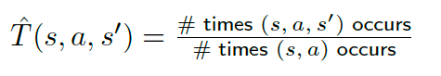

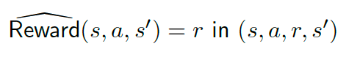
Model-Based Learning
Model-Based Idea:
Learn an approximate model based on experiences
Solve for values as if the learned model were correct
Key idea: model-based learning
Step 1:
Data: s₀; a₁, r₁, s₁; a₂, r₂, s₂; a₃, r₃, s₃; . . . ; a_{n}, r_{n}, s_{n}
Count outcomes s’ for each s, a
Step 2: Solve the learned MDP
Estimate the MDP: T (s, a, s’) and Reward(s, a, s’)

Slide 20
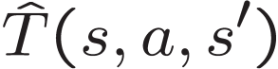
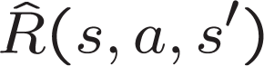
Model-Based Learning
Input Policy π
Observed Episodes (Training)
Learned Model
Episode 1
Episode 2
T(s,a,s’).
T(B, east, C) = 1.00
T(C, east, D) = 0.75
T(C, east, A) = 0.25
…
R(s,a,s’).
R(B, east, C) = -1
R(C, east, D) = -1
R(D, exit, x) = +10
…
 | A
B | C | D
 | E
B, east, C, -1
C, east, D, -1
D, exit, x, +10
B, east, C, -1
C, east, D, -1
D, exit, x, +10
Episode 3
Episode 4
E, north, C, -1
C, east, D, -1
D, exit, x, +10
E, north, C, -1
C, east, A, -1
A, exit, x, -10
Assume: γ = 1

Slide 21
Model-Based Learning
(?): $4
(3/4): $4
(?): $?
in stay
in,stay
quit
(?): $?
(1/4): $4
(?): $4
in,quit
?: $?
end
Data (following policy π(s) = stay):
[in; stay, 4, in; stay, 4, in; stay, 4, in; stay, 4, end]
Transition?
Reward?

Slide 22
Model-Based Learning
(4/6): $4
(3/4): $4
in stay
in,stay
quit
(2/6):$ 4
(1/4): $ 4
in,quit
?: $?
end
Data (following policy π(s) = stay):
[in; stay, 4, in; stay, 4, end]
New Transition?

Slide 23
Model-Based Learning
(4/7): $4
(4/6): $4
in stay
in,stay
quit
(2/6): $ 4
(3/7): $ 4
in,quit
?: $?
end
Data (following policy π(s) = stay):
[in; stay, 4, end]
New Transition?
Estimates converge to true values (under certain conditions)
With estimated MDP (T, Reward), compute policy using value iteration

Slide 24
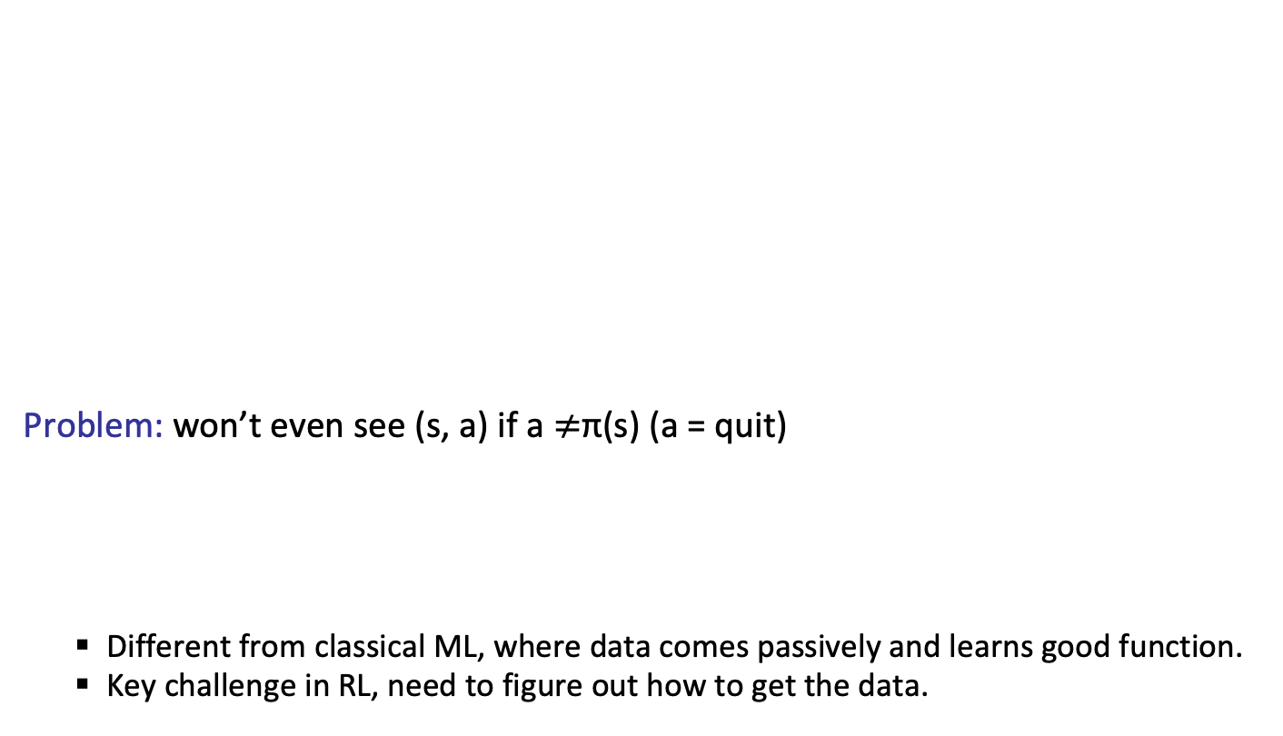
Model-Based Learning
Problem: won’t even see (s, a) if a $≠$π(s) (a = quit)
Different from classical ML, where data comes passively and learns good function.
Key challenge in RL, need to figure out how to get the data.
(4/7): $4
in stay
in,stay
quit
(3/7): $ 4
in,quit
?: $?
end
Problem: ?
Key idea: exploration
To do reinforcement learning, need to explore the state space.
Solution: need π to explore explicitly

Slide 25
Model-Based Learning
(4/7): $4
in stay
in,stay
quit
(3/7): $ 4
in,quit
?: $?
end
Data (following policy π(s) = quit):
[in; quit, R, end]
Transitioning?
Reward?

Slide 26
Model-Based Learning
Summary:
Our policies have been deterministic. However, if we use such a policy to generate data, there are certain (s, a) pairs that we will never see and, therefore, never be able to estimate their Q-value and never know what the effect of those actions are.
This problem points at the most important characteristic of reinforcement learning, which is the need for exploration.
This distinguishes reinforcement learning from supervised learning, because now we actually have to act to get data, rather than just having data poured over us.
if π is a non-deterministic policy that allows us to explore each state and action infinitely often (possibly over multiple episodes), then the estimates of the transitions and rewards will converge.
Once we get an estimate for the T and R, we can simply plug them into our MDP and solve it using standard value or policy iteration to produce a policy.

Slide 27
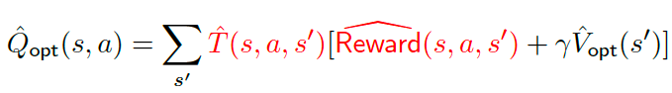
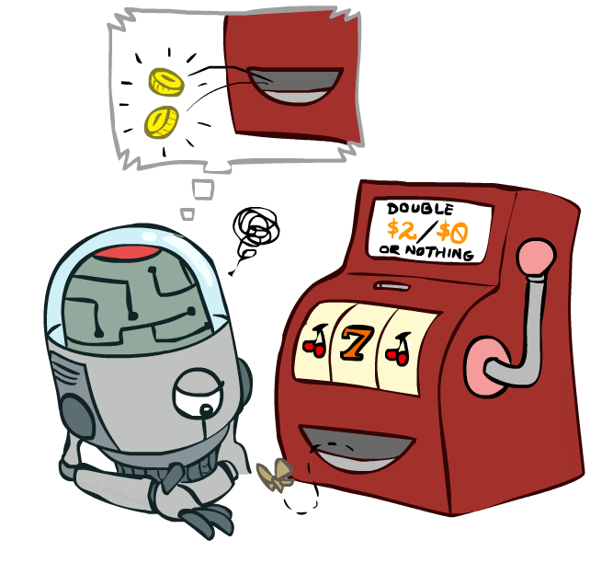
From model-based to model-free
All that matters for prediction is (estimate of) Q_{opt}(s, a).
Key idea: model-free learning
Try to estimate Q_{opt}(s, a) directly.

Slide 28
Model-Free Learning
Data (following policy π):
s₀; a₁, r₁, s₁; a₂, r₂, s₂; a₃, r₃, s₃; . . . ; a_{n}, r_{n}, s_{n}
Recall:
Q_{π} (s, a) is expected utility starting at s, first taking action a, and then following policy π
Utility:
u_{t} = r_{t} + γ · r_{t+1} + γ² · r_{t+2} + · · ·
Estimate:
Q^{ˆ} _{π} (s, a) = average of u_{t} where s_{t−1} = s, a_{t} = a
(and s, a doesn’t occur in s₀, · · · , s_{t−2})

Slide 29
Model-Free Learning
(?): $?
4
?
in stay
in,stay
quit
(?): $?
?
in,quit
?: $?
end
Data (following policy π(s) = stay):
[in; stay, 4, end]
Utility?

Slide 30
Model-Free Learning
(?): $?
4
in,stay
(4+8)/2
in stay
quit
(?): $?
?
in,quit
?: $?
end
Data (following policy π(s) = stay):
[in; stay, 4, in; stay, 4, end]
Utility?

Slide 31
Model-Free Learning
(?): $?
(4+8+16)/3
(4+8)/2
in stay
in,stay
quit
(?): $?
?
in,quit
?: $?
end
Data (following policy π(s) = stay):
[in; stay, 4, in; stay, 4, in; stay, 4, in; stay, 4, end]
Utility?

Slide 32
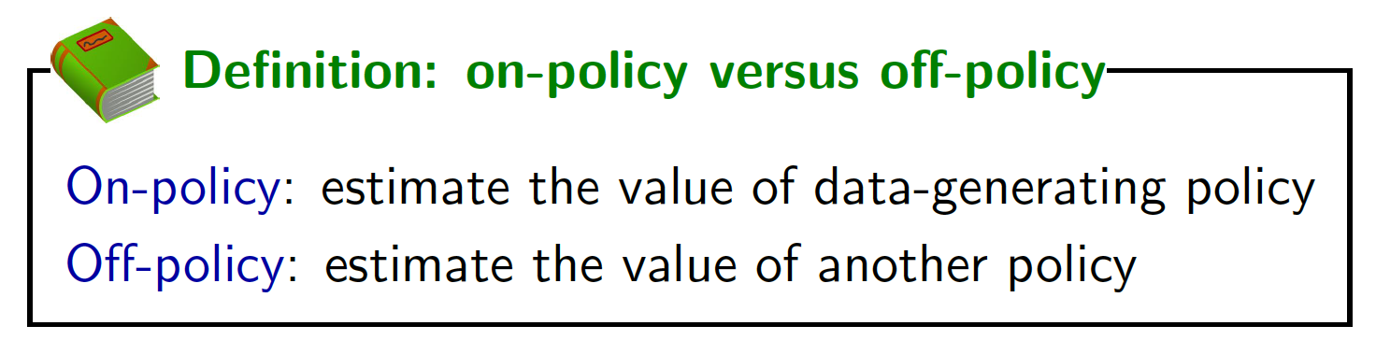
Model-Free Learning
(?): $?
(4+8+16)/3
in stay
in,stay
quit
(?): $?
?
in,quit
?: $?
end
Data (following policy π(s) = stay):
[in; stay, 4, in; stay, 4, in; stay, 4, in; stay, 4, end]
Note: we are estimating Q_{π} now, not Q_{opt}

Slide 33
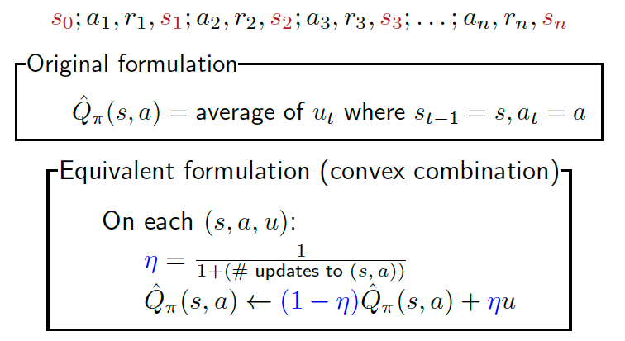
Model-Free Learning (equivalence)
Data (following policy π):

Slide 34
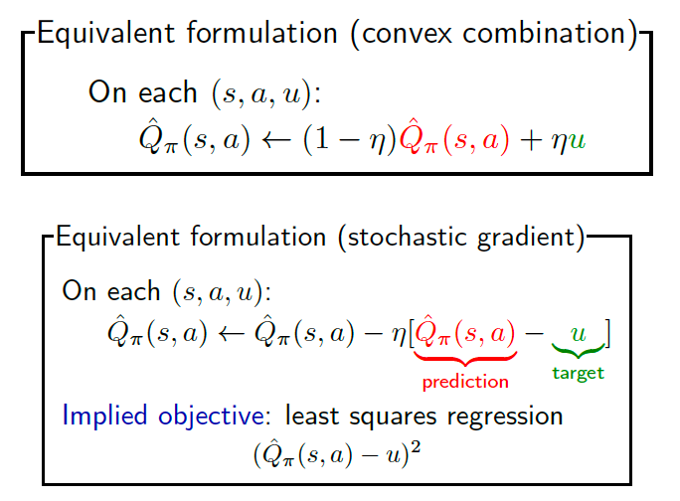
Model-Free Learning

Slide 35
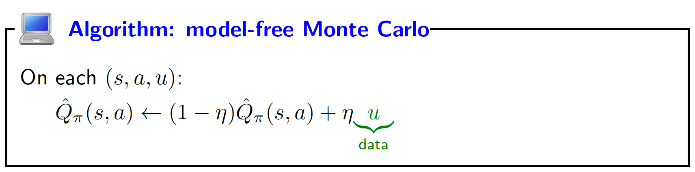
Using the utility
Data (following policy π(s) = stay):
[in; stay, 4, end] u = 4
[in; stay, 4, in; stay, 4, end] u = 8
[in; stay, 4, in; stay, 4, in; stay, 4, end] u= 12
[in; stay, 4, in; stay, 4, in; stay, 4, in; stay, 4, end] u= 16

Slide 36
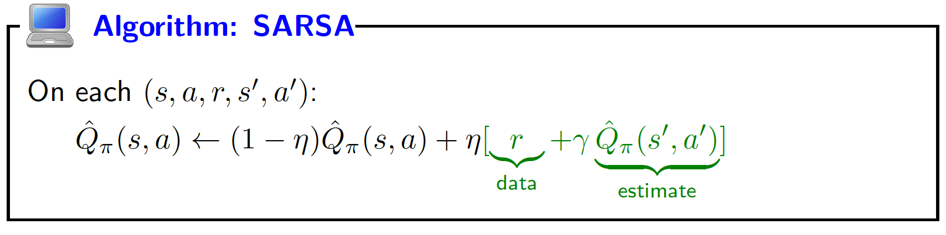
Using the reward + Q-value
Current estimate: Q^{ˆ}_{π} (s, stay) = 11
Data (following policy π(s) = stay):
[in; stay, 4, end] 4+0
[in; stay, 4, in; stay, 4, end] 4+11
[in; stay, 4, in; stay, 4, in; stay, 4, end] 4+11
[in; stay, 4, in; stay, 4, in; stay, 4, in; stay, 4, end] 4+11

Slide 37
Model-free vs. SARSA
Key idea: SARSA
SARSA uses estimate Q^{ˆ}_{π} (s, a) instead of just raw data u.
u
based on one path
large variance
wait until end to update
r + Q^{ˆ}_{π} (s , a ) based on estimate
small variance
can update immediately

Slide 38
Quiz
Which of the following algorithms allows you to estimate Q_{opt}(s, a) (select all that apply)?
model-based learning
model-free learning
SARSA

Slide 39
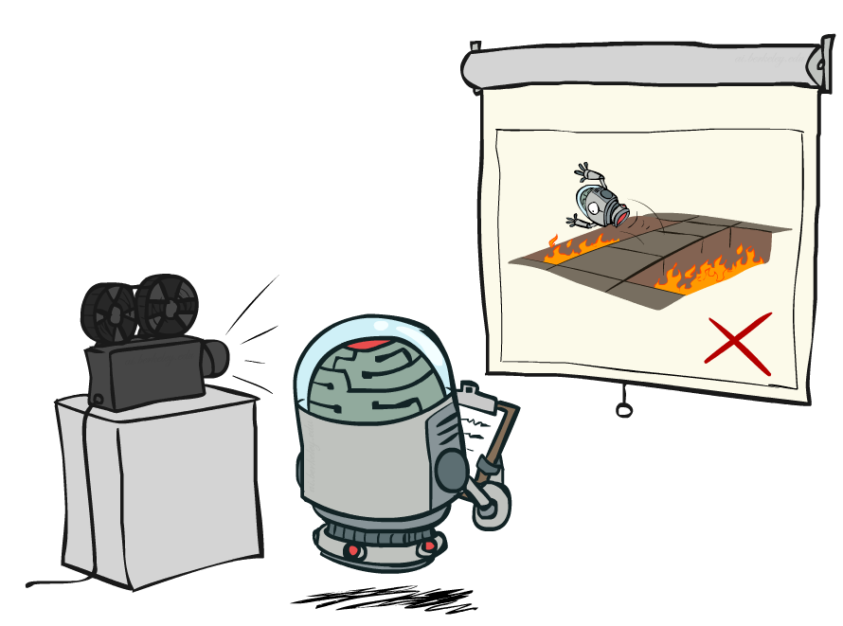
Passive Reinforcement Learning
Simplified task: policy evaluation
Input: a fixed policy π(s)-- told what to do
You don’t know the transitions T(s,a,s’)
You don’t know the rewards R(s,a,s’)
Goal: evaluate how good an policy is,
learn the expected utility U for each s
In this case:
Learner is “along for the ride”
No choice about what actions to take
Just execute the policy and learn from experience
This is NOT offline planning! You actually take actions in the world.

Slide 40
Direct Evaluation
Goal: Compute values for each state under π
Idea: Average together observed sample values
Act according to π
Every time you visit a state, write down what the sum of discounted rewards turned out to be
Average those samples
This is called direct evaluation

Slide 41
Example: Direct Evaluation
Input Policy π
Observed Episodes (Training)
Output Values
Episode 1
Episode 2
-10
 | A
B | C | D
 | E
B, east, C, -1
C, east, D, -1
D, exit, x, +10
B, east, C, -1
C, east, D, -1
D, exit, x, +10
 | A
B | C | D
 | E
+8
+4
+10
Episode 3
Episode 4
-2
E, north, C, -1
C, east, D, -1
D, exit, x, +10
E, north, C, -1
C, east, A, -1
A, exit, x, -10
Assume: γ = 1

Slide 42
Problems with Direct Evaluation
What’s good about direct evaluation?
It’s easy to understand
It doesn’t require any knowledge of T, R
It eventually computes the correct average values, using just sample transitions
What bad about it?
It wastes information about state connections
Each state must be learned separately
So, it takes a long time to learn
Output Values
-10
 | A
B | C | D
 | E
+8
+4
+10
-2

Slide 43
Temporal Difference Learning (TD)
Big idea: learn from every experience!
Update V(s) each time we experience a transition (s, a, s’, r)
Likely outcomes s’ will contribute updates more often
Temporal difference learning of values
Policy still fixed, still doing evaluation!
Move values toward value of whatever successor occurs: running average
s
π(s)
s, π(s)
s’
Sample of V(s):
Update to V(s):
Same update:

Slide 44
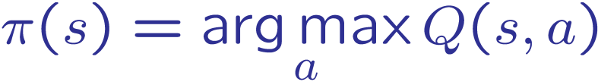
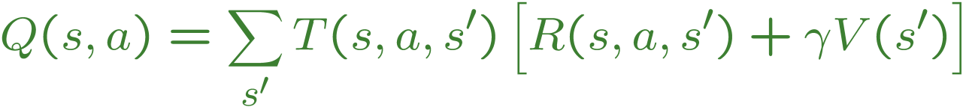
Problems with TD Value Learning
TD value leaning is a model-free way to do policy evaluation, mimicking Bellman updates with running sample averages
However, if we want to turn values into a (new) policy, we’re sunk:
Idea: learn Q-values, not values
Makes action selection model-free too!
s
a
s, a
s,a,s’
s’

Slide 45
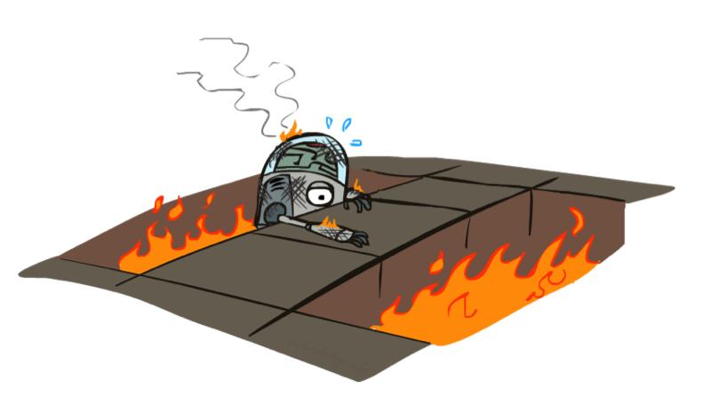
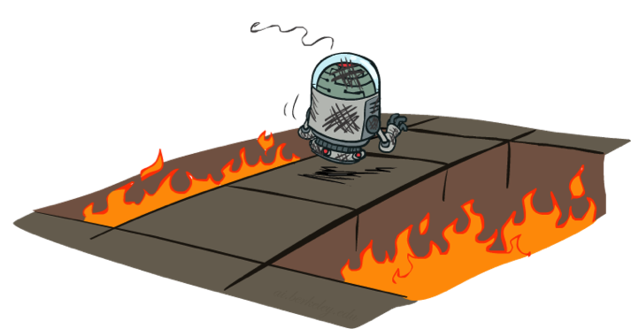
Active Reinforcement Learning
Problem: model-free and SARSA only estimate Q_{π} , but want Q_{opt} to act optimally
Output
Q_{π} Qopt
MDP
policy evaluation value iteration
reinforcement learning
model-free, SARSA
Q-learning

Slide 46
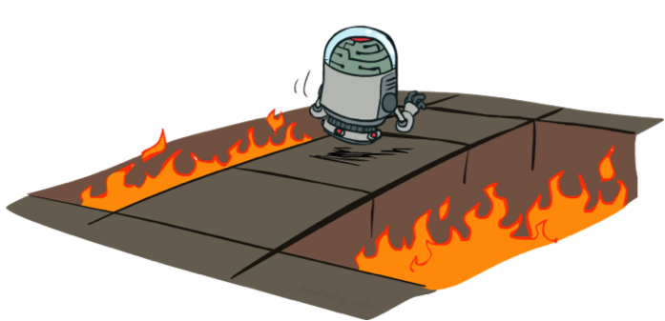
Active Reinforcement Learning
Full reinforcement learning: optimal policies (like value iteration)
You don’t know the transitions T(s,a,s’)
You don’t know the rewards R(s,a,s’)
You choose the actions now
Goal: learn the optimal policy / values
In this case:
Learner makes choices!
Fundamental tradeoff: exploration vs. exploitation
This is NOT offline planning! You actually take actions in the world and find out what happens…

Slide 47
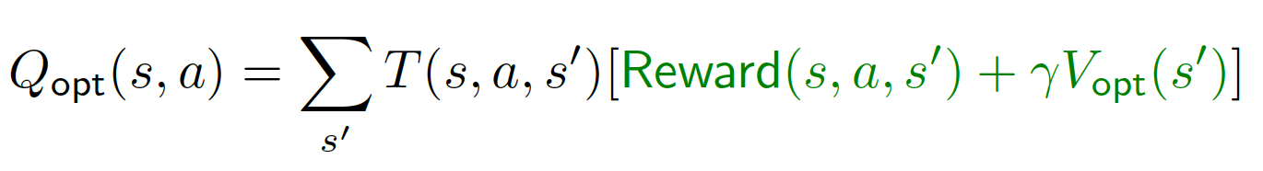
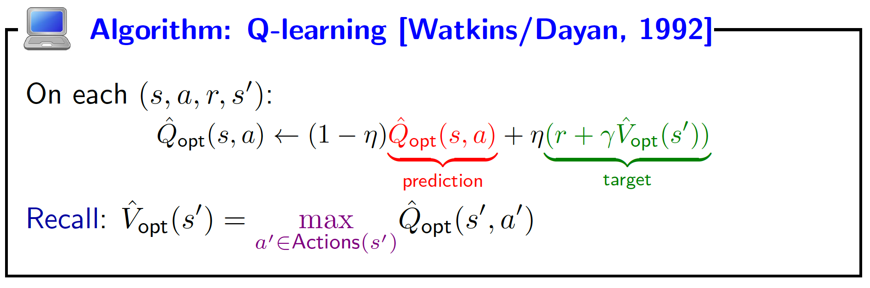
Q-Learning
MDP recurrence:

Slide 48
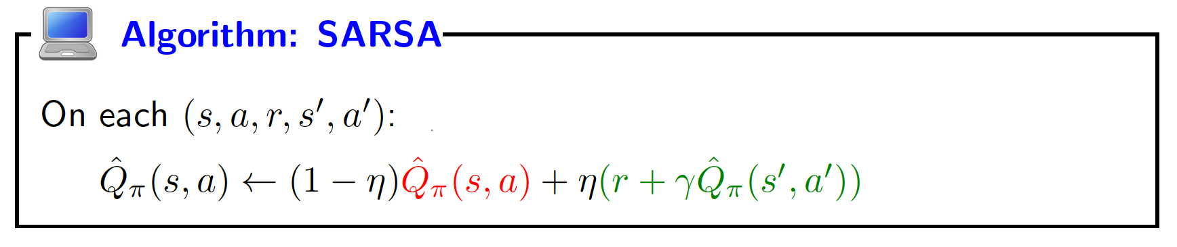
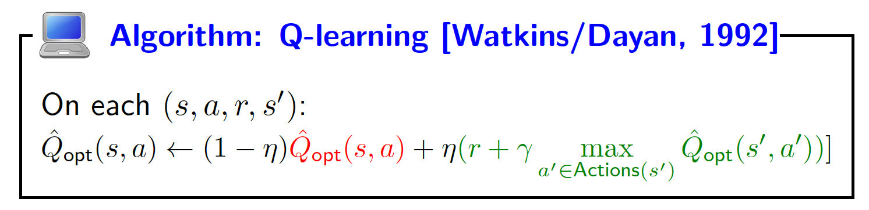
SARSA vs. Q-learning

Slide 49

Q-Learning Properties
Amazing result: Q-learning converges to optimal policy -- even if you’re acting suboptimally!
This is called off-policy learning
Caveats:
You have to explore enough
You have to eventually make the learning rate
small enough
… but not decrease it too quickly
Basically, in the limit, it doesn’t matter how you select actions (!)

Slide 50
Exploration
Algorithm: reinforcement learning
For t = 1, 2, 3, . . .
Choose action a_{t} = π_{act}(s_{t−1}) (how?)
Receive reward r_{t} and observe new state s_{t}
Update parameters (how?)
s₀; a₁, r₁, s₁; a₂, r₂, s₂; a₃, r₃, s₃; . . . ; a_{n}, r_{n}, s_{n}
Which exploration policy π_{act} to use?

Slide 51
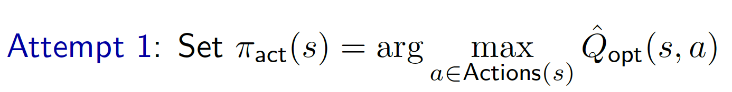

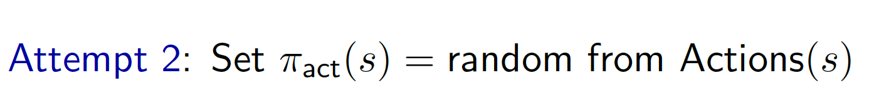

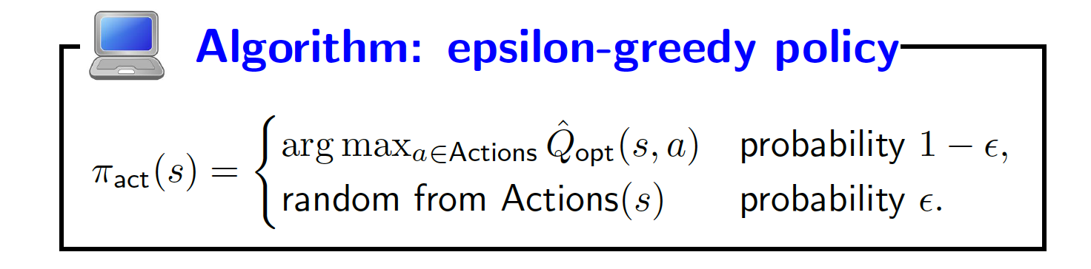
Exploration/exploitation tradeoff
No exploration, all exploitation
No exploitation, all exploration
Key idea: balance
Need to balance exploration and exploitation.
Examples from life: restaurants, routes, research

Slide 52
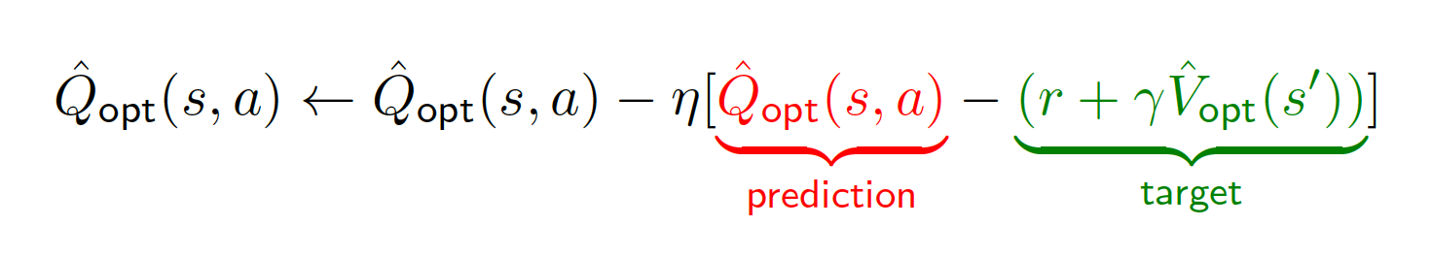
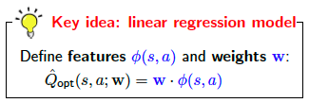
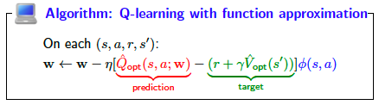
Q-Learning
Stochastic gradient update:
This is rote learning: every Q_{opt}(s, a) has a different value
Problem: doesn’t generalize to unseen states/actions
Solution: Function approximation

Slide 53
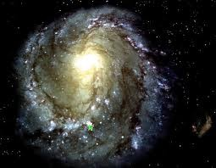
Covering the unknown
Epsilon-greedy: balance the exploration/exploitation tradeoff
Function approximation: can generalize to unseen states

Slide 54
Summary so far
Online setting: learn and take actions in the real world!
Exploration/exploitation tradeoff
Estimate transitions, rewards, Q-values from data
Update towards target that depends on estimate rather than just raw data

Slide 55
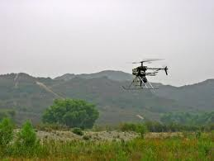
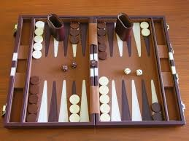


Applications
Autonomous helicopters: control helicopter to do maneu- vers in the air
Backgammon: TD-Gammon plays 1-2 against itself, human-level performance
million
games
Elevator scheduling; send which elevators to which floors to maximize throughput of building
Managing datacenters; actions: bring up and shut down machine to minimize time/cost

Slide 56
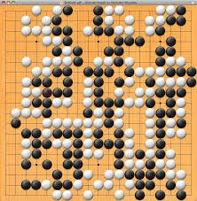
Deep reinforcement learning
Policy gradient: train a policy π(a | s) (say, a neural network) to directly maximize expected reward
Google DeepMind’s AlphaGo (2016), AlphaZero (2017)
Andrej Karpathy’s blog post
http://karpathy.github.io/2016/05/31/rl
https://www.youtube.com/watch?v=SUbqykXVx0A

